Slide 1
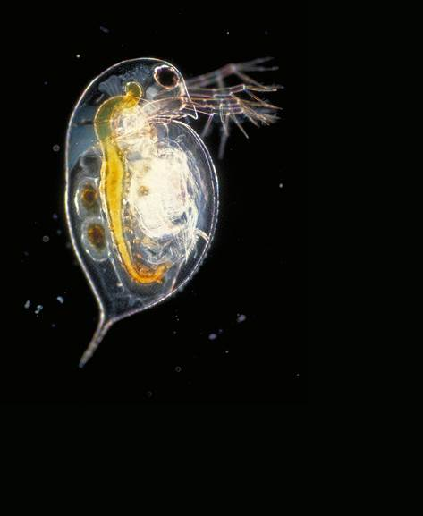
The effect of genotypic diversity on evolution under copper stress in Daphnia pulex and Daphnia pulicaria
PIUMI ABEYNAYAKA
SUPERVISORS: GREGOR FUSSMANN AND MELANIA CRISTESCU

Slide 2
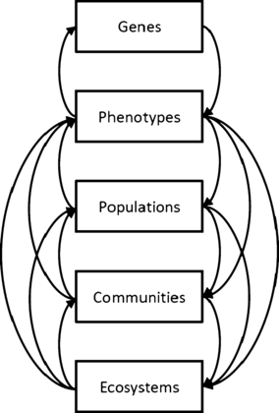
From genes to ecosystems: an emerging synthesis of eco‐evolutionary dynamics
New Phytologist
Volume 184, Issue 4, pages 746-749, 6 NOV 2009 DOI: 10.1111/j.1469-8137.2009.03081.x
http://onlinelibrary.wiley.com/doi/10.1111/j.1469-8137.2009.03081.x/full#f1
Notes:
Conceptual model of dynamic eco‐evolutionary feedbacks, demonstrating the potential feedbacks from genes to phenotypes across population, community and ecosystem levels of organization.
© This slide is made available for non-commercial use only. Please note that permission may be required for re-use of images in which the copyright is owned by a third party.

Slide 3
Question
How does diversity affect evolutionary changes in Daphnia populations under copper stress?
Or, more specifically:
How does diversity affect changes in population size in Daphnia populations under copper stress?

Slide 4
Hypotheses
Population size
Genotypic diversity will enhance average population size and population stability under both Cu and non-Cu conditions.

Slide 5
Toxicity tests
Preliminary issues:
Determine whether pond and lake Daphnia differ significantly in their copper tolerances.
Determine a copper concentration for use in the experiment: should yield ~10% mortality of lines per habitat.

Slide 6
Preliminary 1:
Range finder test
  8 habitats: 4 ponds and 4 lakes
  1 random isolate from each habitat replicated x2
  5 Cu concentrations
    0, 25, 75, 125, 175 ug/L
  5 neonates per concentration
Eg. Solomon
Habitat
Clone line
1
Replicate
a
b
x 5 neonates
0 25 75 125 175
µg Cu/ L

Slide 7

Preliminary 1:
Results

Slide 8
Preliminary 2:
Acute toxicity test
All 12 habitats: 5 lakes, 7 ponds
2 lines per habitat
2 replicates per line
8 Cu concentrations
  A no copper control + 7
  Determined post range-finder
  Might need to expose pond and lake daphnia to different ranges
5 neonates per concentration
10% mortality per lines
Eg. Solomon
Habitat
2
Clone line
1
Replicate
a
b
a
b
x 5 neonates
Eg.
0 145 150 155 160 165 170 175
µg Cu/ L

Slide 9
Preliminary 2:
Results

Slide 10
Experimental design:
Tank Set-up
 | No diversity (monoculture) |  |  | Low diversity |  |  | High diversity
 | Tank pair 1 | Tank pair 2 | Tank pair 3 | Tank pair 4 | Tank pair 5 | Tank pair 6 | Tank pair 7 | Tank pair 8 | Tank pair 9
No copper | A | B | C | ABC + DEF | ABC + GHI | ABC + JKL | A-L (12) + M-X (12) | A-L + Y-JJ (12) | A-L + KK-UU (12)
Copper | A | B | C | ABC + DEF | ABC + GHI | ABC + JKL | A-L (12) + M-X (12) | A-L + Y-JJ (12) | A-L + KK-UU (12)

Slide 11
Experimental Design: Choosing lines
Library: 16 habitats (8 ponds and 8 lakes) - Illinois, Michigan, Minnesota, and Ontario
  Eliminate 4 habitats
  →12 habitats: 7 ponds (Illinois, Ontario, Michigan), 5 lakes (Illinois, Ontario)
Ponds vs. lakes?
  Depends on tox test results
Total 48 genotypes selected with an even distribution across all habitats
  Choose subset of 12 for low diversity randomly
  Choose subset of 3 for monocultures randomly

Slide 12
Analysis
Population size
Average population size per tank over time
Coefficient of variance per tank to estimate population stability through time
Use MANOVA? Or split-plot ANOVA?

Slide 13
Future Directions

